Slide 1
Credit-Card Approval Project
By abhijeet sethy

Slide 2


Problem statement:
A bank's credit card department is one of the top adopters of data science. A top focus for the bank has always been acquiring new credit card customers. Giving out credit cards without doing proper research or evaluating applicants' creditworthiness is quite risky. So, here we will try to make Machine Learning models to predict customer worthiness of getting a credit card.
This presentation will explore the use of machine learning to predict credit card approval rates. We will explore various machine learning models and evaluate their performance on a real-world dataset.

Slide 3
Steps followed
This step includes the use of a
real world data-set of
credit card applications and approvals.
Different models are considered for predicting the credit card approval rates like Logistic Regression, Decision Tree, XG Boost, KNN and Random Forest.
We will compare the performance of the different models and select the
best model for predicting credit card approval rates.
Data acquisition
model selection
Model comparison
Data preprocessing
Model training & evaluation
The data was cleaned and pre-processed to ensure that
it was suitable for machine learning modeling.
This included steps such as missing value imputation,
outlier detection, and feature scaling.
Each model is trained on the pre-processed data
and its performance is evaluated using metrics such as
accuracy, precision, recall and F1 score.

Slide 4
Dataset & Features :
Here I was given two datasets :
1. Credit_Card.csv
This dataset consists of 18 features, as given below:
Members: Family
Ind_ID: Client ID
Gender: Gender information
Car_owner: Having car or not
Propert_owner: Having property or not
Children: Count of children
Annual_income: Annual income
Type_Income: Income type
Education: Education level
Marital_status: Marital_status
Housing_type: Living style
Birthday_count: Use backward count from current day (0), -1 means yesterday.
Employed_days: Start date of employment. Use backward count from current day (0). Positive value means, individual is currently unemployed.
Mobile_phone: Any mobile phone
Work_phone: Any work phone
Phone: Any phone number
EMAIL_ID: Any email ID
Type_Occupation: Occupation
Familysize
2. Credit_card_label.csv
This dataset has 2 features, as given below:
Ind_ID: Client ID
Label: Whether worthy for Credit or not

Slide 5
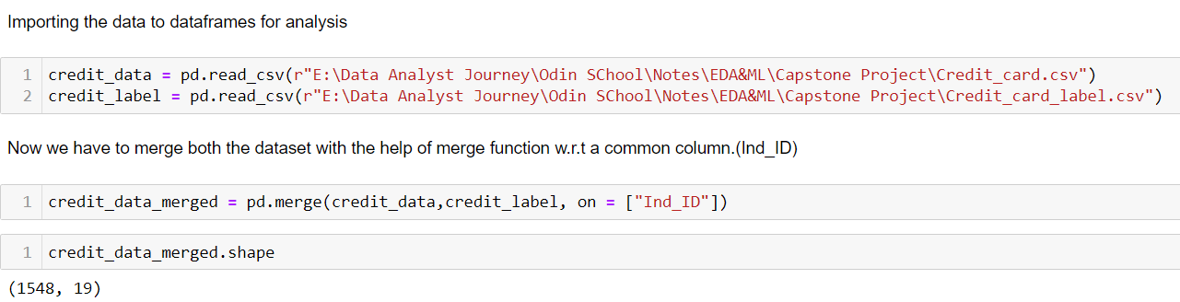
Data acquisition and understanding:
I was given two datasets having a common column named as “Ind_ID”.
Merging both datasets:
Upon merging the datasets using the common column "Ins_ID," it becomes evident that the resulting dataset possesses a comprehensive structure. Specifically, the amalgamated dataset comprises a total of 19 columns and 1548 rows. This integration of information facilitates a more comprehensive analysis and exploration of the data, enabling a deeper understanding of the underlying patterns and relationships within the dataset. The increased dimensionality resulting from the merging process enhances the dataset's richness and provides a solid foundation for subsequent analytical tasks.

Slide 6
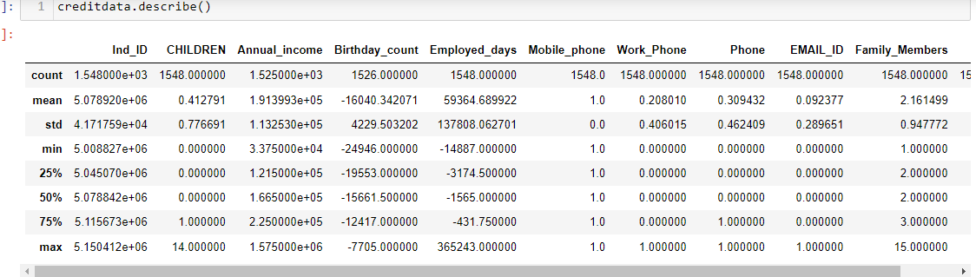
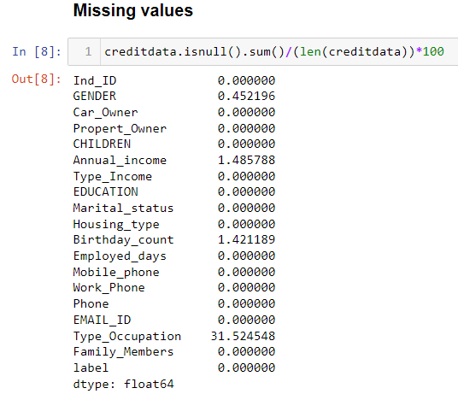
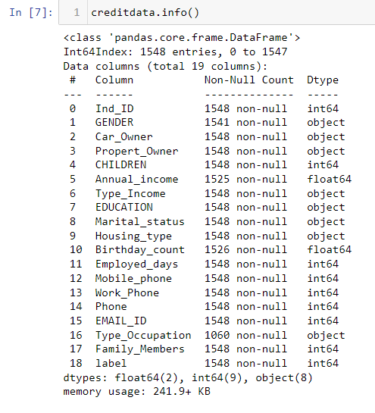
Checking the statistical details of the dataset using “describe()” as can be seen in Fig-1.
Using “info()” function we can check datatypes of the features, which are mostly of String type as shown in Fig-2.
In Fig-3 we can check the percentage of null or NA values present in the dataset. “Type_of_occupation ” feature having most of the Null values i.e. 31 % of total dataset.
(Fig-1)
(Fig-3)
(Fig-2)

Slide 7
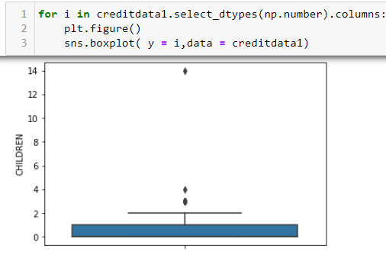
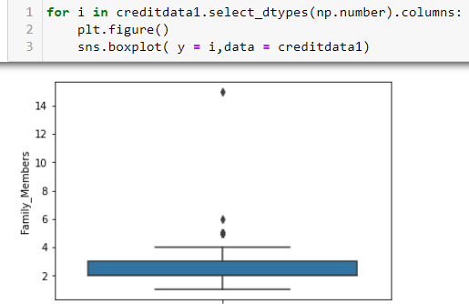
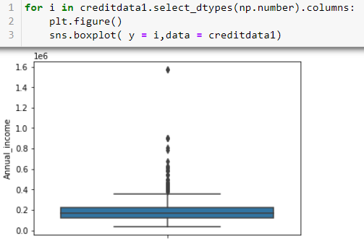
Outlier:
An outlier is an observation or data point that deviated significantly from the rest of the dataset. In other words ,it’s a data point that lies an abnormal distance away from the other values in a random sample from a population
Outliers are checked if present in this step : A for loop is used here to draw box plots for each feature. It can be seen that there are outliers present in some features like “Children” ,”Family_memebers” and “Annual Income”. (The black dots in the chart)

Slide 8
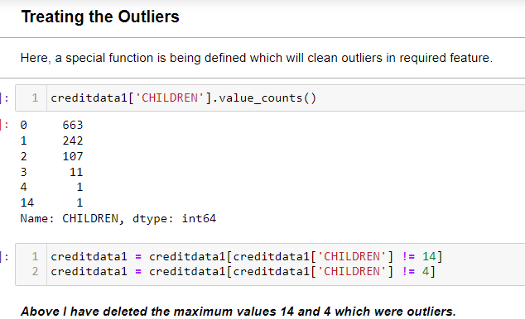
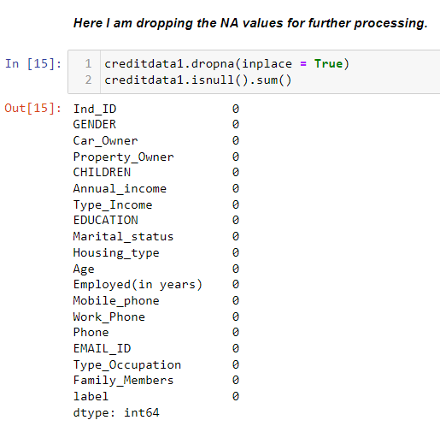
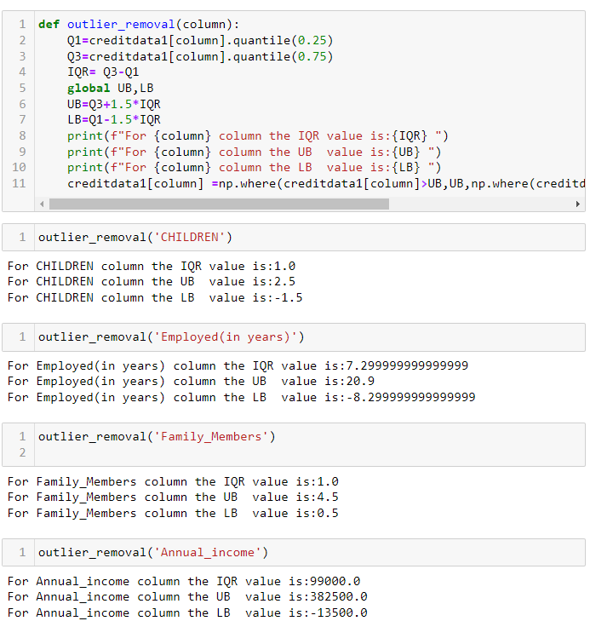
Data cleaning:
Here, I have dropped the null values, as the most significant amount of null values present is 31.5% in an independent feature. Additionally, while treating outliers, I encountered the "Children" feature, which had a maximum values like 14 and 4, indirectly affecting the "Family_members" feature as well. Consequently, I dropped those rows to normalize the data.
Subsequently, I defined a function which employed the IQR method for outlier treatment, wherein I replaced the outliers with the upper and lower bound values of the respective features.

Slide 9
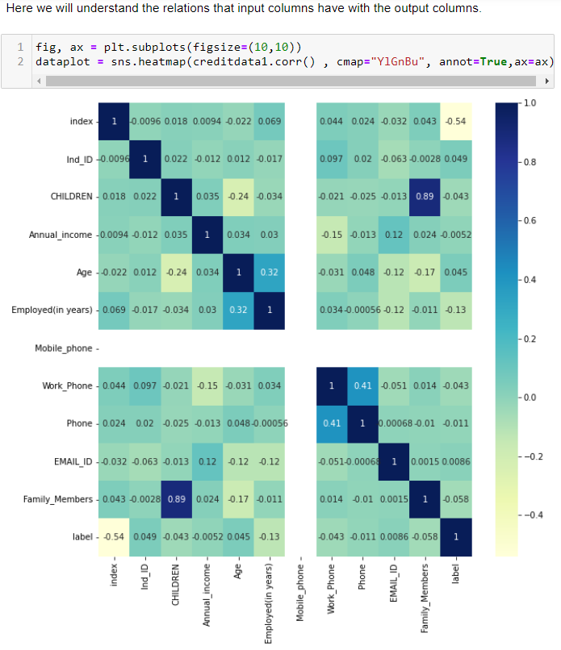
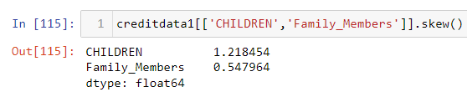
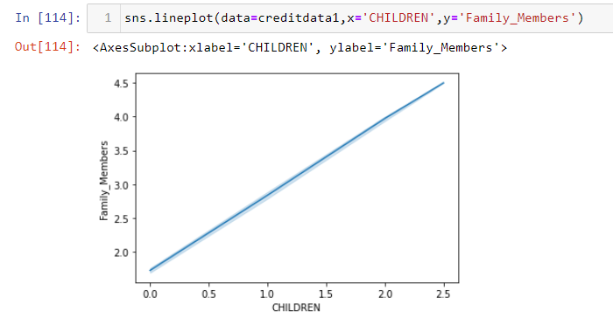
MULTIVARIATE ANALYSIS:
Here it is to be noticed that ‘Children’ and ‘Family_Members’ are highly dependent with each other .So it is always advised to drop one of them or both of them.
I am dropping the children feature as it has skewed data which indicates that it is not normally distributed.

Slide 10
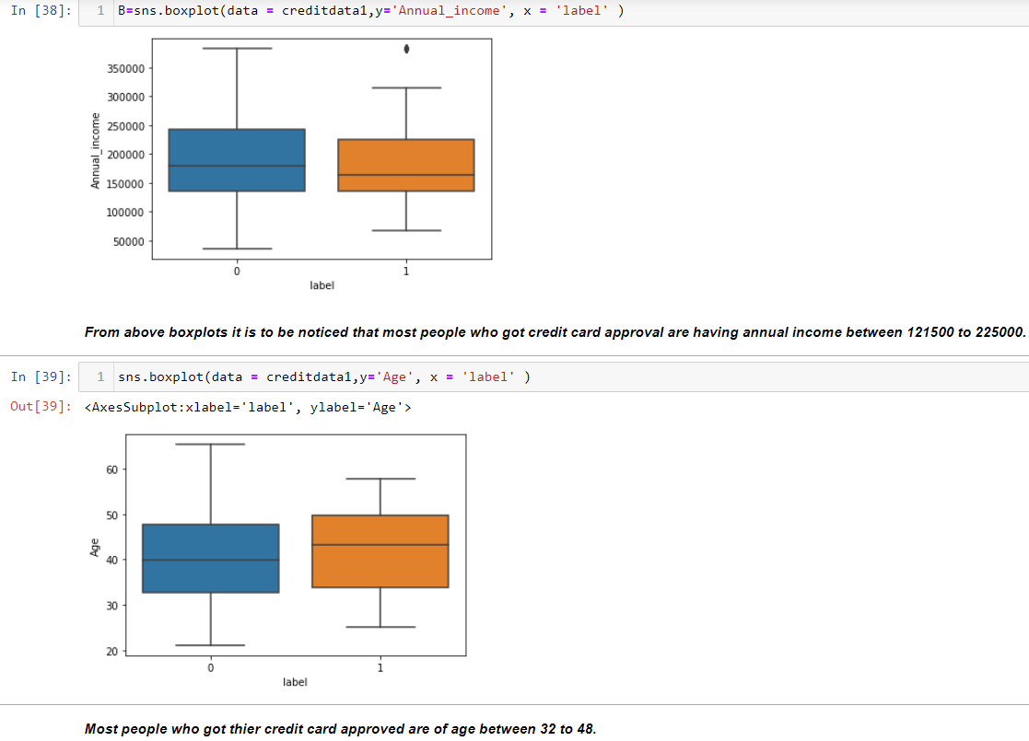
BIVARIATE ANALYSIS:
Upon conducting bivariate analysis, a noteworthy trend has emerged. Individuals with an annual income falling within the range of 1,21,500 to 2,25,000 exhibit a significantly higher likelihood of acquiring a credit card. This suggests a positive correlation between income levels within this bracket and the propensity to possess a credit card.
In addition to income analysis, a detailed examination of the Age feature has revealed a distinct pattern. Individuals within the age bracket of 32 to 48 exhibit a notably elevated likelihood of obtaining a credit card.
The results from the bivariate analysis underscore the significance of both income and age in predicting credit card ownership. As we move forward with our analysis, these insights will serve as crucial inputs for building a robust predictive model.

Slide 11
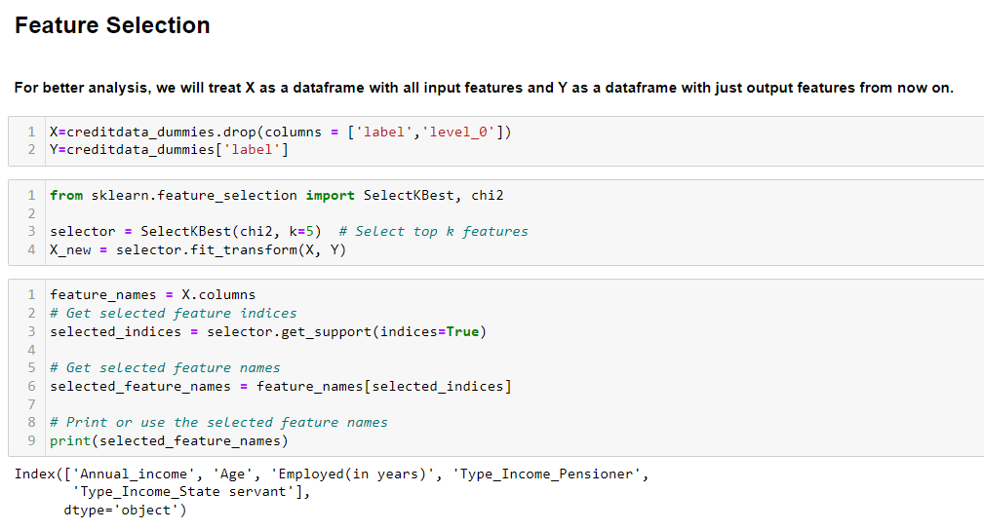
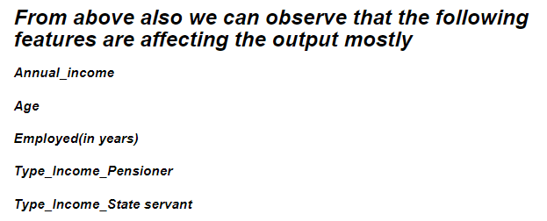
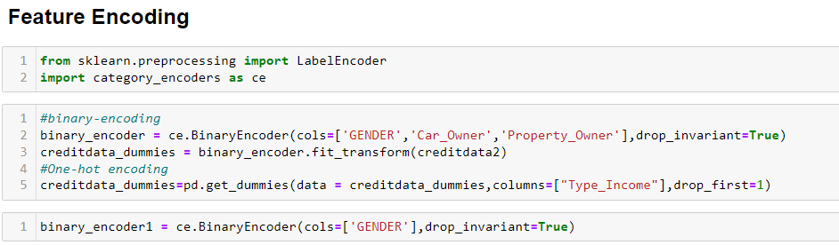
Feature selection and encoding:
In terms of feature selection, I used the chi square Test as a testing criterion to help determine the need for that specific feature.
It eventually presented us with five critical features that can be used to create models.
Once I received the corresponding features, I encoded them using various encoding techniques.
Encoding is essential because it aids in the conversion of categorical data to machine-readable numerical values.

Slide 12
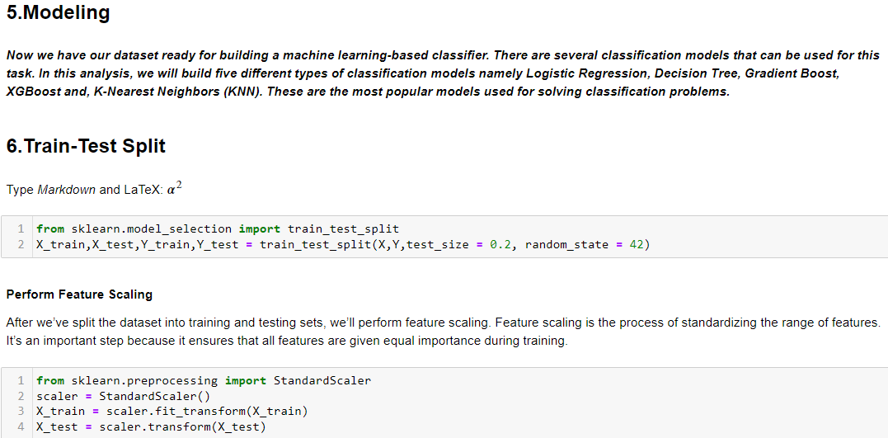
Model selection
To achieve the highest accuracy, various machine learning algorithms, such as Logistic Regression, Decision Tree, XGboost, and k-nearest Neighbors, are evaluated.
The primary dataset is divided into training and testing data to assess the model's accuracy, with 80% allocated for training and 20% for testing. Subsequently, the process of standardizing the range of features is performed to ensure equal importance is given to all features during training.

Slide 13
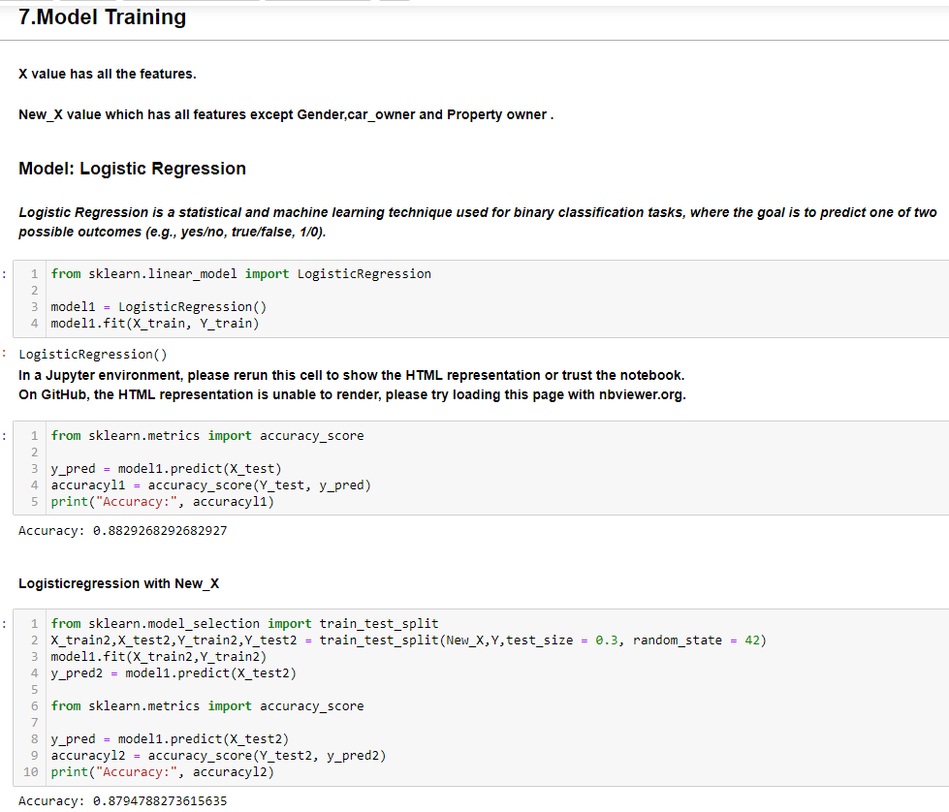
Logistic regression:
Model training and evaluation:
For each model I have provided with two datasets one containing all the features(X) and one with only selected features (New_X) for training in order to check their effect on the accuracy of the model.
Logistic Regression is a statistical method used for binary classification problems, where the outcome variable is categorical and has two classes (e.g., 0 or 1, True or False, Yes or No). Despite its name, logistic regression is a classification algorithm rather than a regression algorithm.
The accuracy score came as 88.3% for first case and for second case it comes as 87.9%.

Slide 14
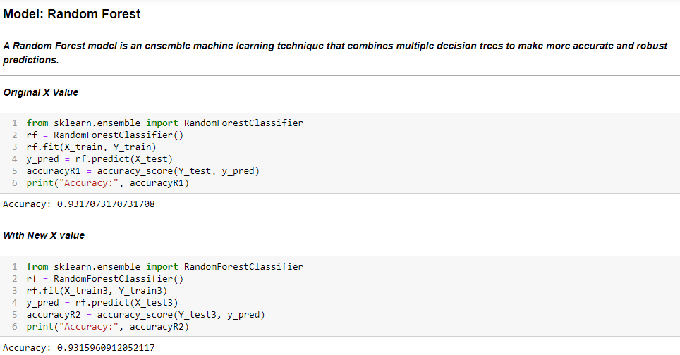
Random forest model:
A Random Forest is an ensemble learning method that operates by constructing a multitude of decision trees at training time and outputting the class that is the mode of the classes (classification) or mean prediction (regression) of the individual trees.
The "random" in Random Forest comes from the use of random subsamples of the dataset and random feature selection during the training process.
Here we can see the accuracy score is 93.17% for original X value and 93.15 for New_X value.

Slide 15
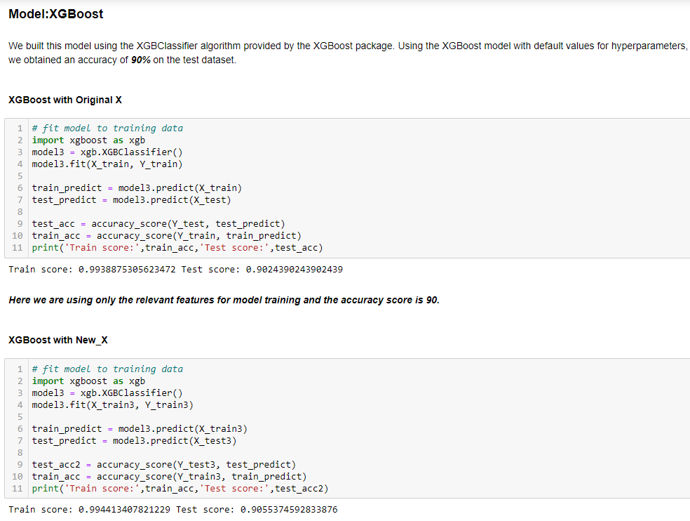
XGBoost model:
XGBoost, which stands for Extreme Gradient Boosting, is a powerful and widely used machine learning algorithm known for its efficiency and predictive performance. It belongs to the family of ensemble learning methods, specifically gradient boosting frameworks.
XGBoost is an ensemble learning method, which means it builds a strong predictive model by combining the predictions of multiple weaker models. In this case, the weaker models are decision trees.
Here we can see that the first model that uses original X values is giving 90.24 % and for the New_X dataset the accuracy result is 90.55%.

Slide 16
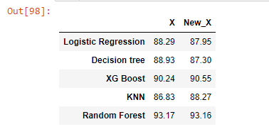
Model comparison:
In conclusion, the performance evaluation of various models indicates consistently good accuracy results. Upon sorting, the top-performing models in descending order are:
1. Random Forest
2. XGBoost
3. Logistic Regression
Considering these results, the Random Forest model stands out as the top performer. Therefore, for model deployment, it is recommended to utilize the Random Forest model due to its robust and reliable predictive capabilities. The ensemble nature of Random Forest, along with its ability to handle diverse datasets and maintain high accuracy, makes it a suitable choice for practical applications.

